Slide 1


.
Customer Behavior Analysis and Churn Prediction in
E-Commerce Using BI and ML

Slide 2
In a fast-paced e-commerce world, acquiring customers is costly…
But losing them? Even costlier.
The key to success lies not in acquisition—but in retention.
Let’s follow the data trail to discover why customers leave—and how we can make them stay.
Once Upon a Market…

Slide 3
Too many customers churn.
- No clear way to predict who’s at risk.
- No personalization for different customer types.
We needed a data-driven, scalable, and actionable solution.
The Problem We Faced

Slide 4
Goal:
To decode customer behavior and prevent churn using data science.
Objectives:
Identify churn risk factors
Predict who will churn
Segment users into behavior-driven groups
Build Power BI dashboards to drive action
Our
Mission

Slide 5
We combined the power of:
- Business Intelligence (BI)
- Descriptive and Exploratory Data Analysis
- Statistical Testing
- Machine Learning
- Clustering Algorithms
- Interactive Dashboards
The Tools
For Our Journey

Slide 6
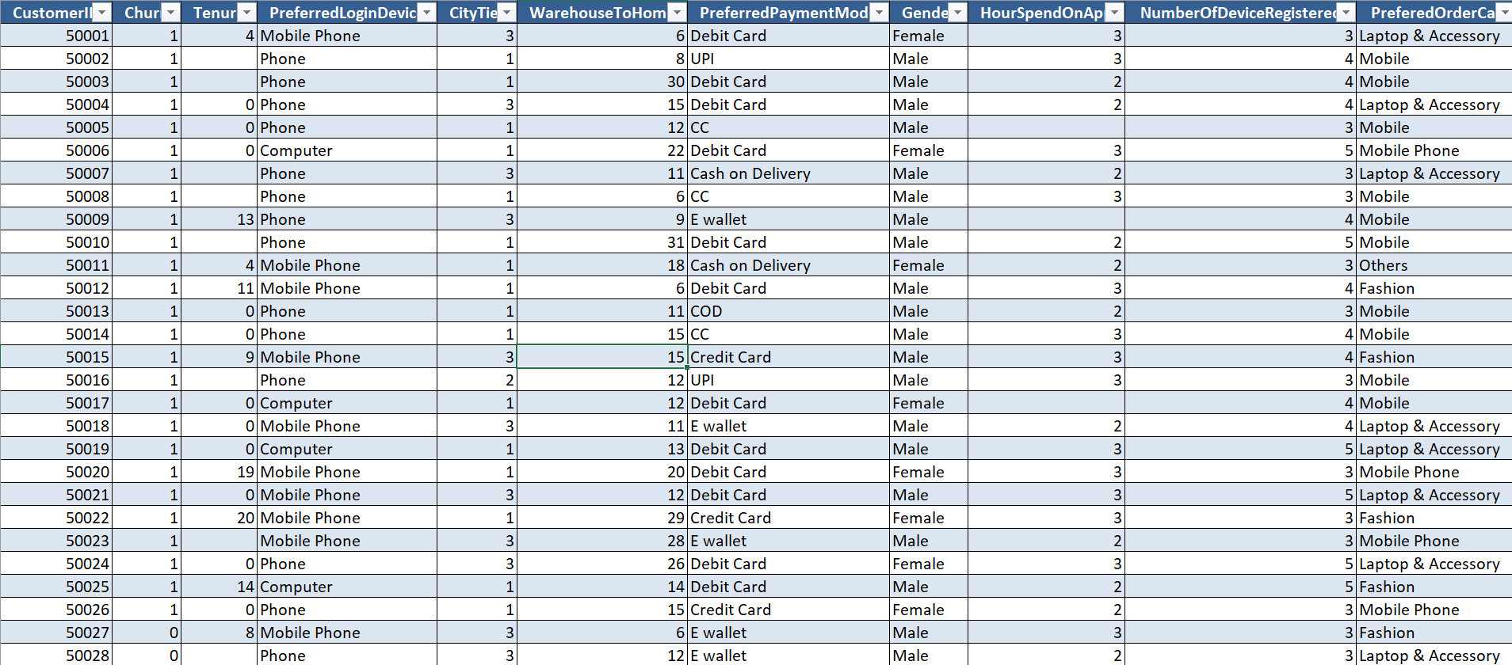
Getting to Know Our Customers
We explored a dataset from Kaggle with over 5,000 records.
It included: Tenure, Order count, Cashback amount, Complaints, Coupon usage, App engagement etc…..
And our target: Did they churn? Yes or No

Slide 7
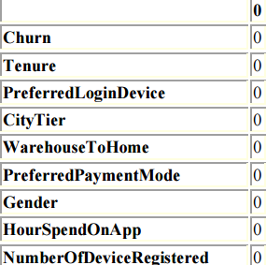
Cleaning Up the Data
Filled missing values
Removed Duplicates
Handled Outliers
This code fills missing values in key columns to ensure the dataset is clean and ready for analysis
In [10]:
data['Tenure'].fillna(data['Tenure'].median(), inplace=True)
data['WarehouseToHome'].fillna(data['WarehouseToHome'].mean(), inplace=True)
data['HourSpendOnApp'].fillna(data['HourSpendOnApp'].median(), inplace=True)
data['OrderAmountHikeFromlastYear'].fillna(data['OrderAmountHikeFromlastYear'].median(), inplace=True)
data['CouponUsed'].fillna(data['CouponUsed'].median(), inplace=True)
data['OrderCount'].fillna(data['OrderCount'].median(), inplace=True)
data['DaySinceLastOrder'].fillna(data['DaySinceLastOrder'].median(), inplace=True)

Slide 8

Cleaning Up the Data
Filled missing values
Removed Duplicates
Handled Outliers
Removes any duplicated (repeated) rows from dataset and keeps only the first occurrence of each unique row.
Number of rows became 5072.
In [13]: data = data.drop_duplicates()
In [14]: data.duplicated().value_counts()

Slide 9
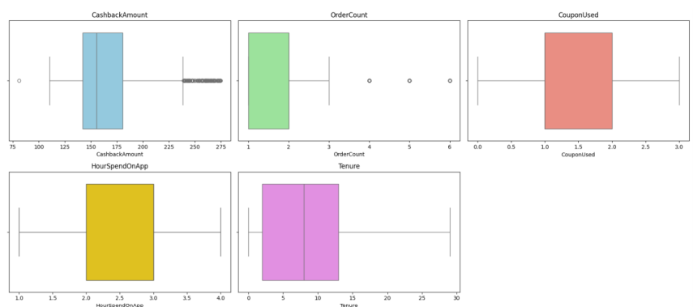
Cleaning Up the Data
Filled missing values
Removed Duplicates
Handled Outliers
This code removes outlier values in key columns to ensure the dataset is clean and ready for analysis
In [16]:
def remove_outliers_iqr(data, columns):
for col in columns:
Q1 = data[col].quantile(0.25)
Q3 = data[col].quantile(0.75)
IQR = Q3 - Q1
lower = Q1 - (1.5 * IQR)
upper = Q3 + (1.5 * IQR)
data = data[(data[col] >= lower) & (data[col] <= upper)]
return data
cols_to_check = ['CashbackAmount', 'OrderCount', 'CouponUsed', 'HourSpendOnApp' ,'Tenure']
data = remove_outliers_iqr(data, cols_to_check)

Slide 10
data[columns].describe()
 | Tenure | Order Count | CashbackAmount | Coupon Used | Hour Spend On App | Order Amount Hike From Last Year | Number Of Device Registered | Day Since Last Order | Number Of Address | Satisfaction Score | Complain
count | 3856 | 3856 | 3856 | 3856 | 3856 | 3856 | 3856 | 3856 | 3856 | 3856 | 3856
mean | 8.59 | 1.90 | 164.39 | 1.15 | 2.92 | 15.71 | 3.66 | 3.72 | 4.18 | 3.01 | 0.28
std | 7.40 | 1.01 | 34.12 | 0.83 | 0.69 | 3.58 | 1.03 | 3.08 | 2.59 | 1.37 | 0.45
min | 0.00 | 1.00 | 81.00 | 0.00 | 1.00 | 11.00 | 1.00 | 0.00 | 1.00 | 1.00 | 0.00
25% | 2.00 | 1.00 | 141.98 | 1.00 | 2.00 | 13.00 | 3.00 | 2.00 | 2.00 | 2.00 | 0.00
50% | 8.00 | 2.00 | 155.62 | 1.00 | 3.00 | 15.00 | 4.00 | 3.00 | 3.00 | 3.00 | 0.00
75% | 13.00 | 2.00 | 180.61 | 2.00 | 3.00 | 18.00 | 4.00 | 5.00 | 6.00 | 4.00 | 1.00
max | 29.00 | 6.00 | 274.65 | 3.00 | 4.00 | 26.00 | 6.00 | 31.00 | 22.00 | 5.00 | 1.00
Exploring the World of Customers
Tenure : (mean ≈ 8.6 months) → focus on onboarding and early retention.
OrderCount: Avg. orders ≈ 2 → low engagement overall.
CashbackAmount: avg. ≈ 164 → can be tested for impact on retention.
CouponUsed :Most use 2–3 coupons → indicates price sensitivity.
HourSpendOnApp :Avg. ≈ 15.7 hours → strong feature for segmentation or churn prediction.
OrderAmountHikeFromLastYear : customer loyalty → useful for churn models.
DaySinceLastOrder : Recent orders → important churn predictor.
SatisfactionScore : Avg. ≈ 3 → neutral satisfaction. Opportunities to improve customer experience.
Complain : 28% complain → likely correlated with churn.

Slide 11
In [20]:data.describe(include='object')
Exploring the World of Customers
 | Preferred Login Device | Preferred Payment Mode | Gender | Prefered Order Cat | Marital Status
count | 3856 | 3856 | 3856 | 3856 | 3856
unique | 3 | 7 | 2 | 5 | 3
top | Mobile Phone | Debit Card | Male | Laptop & Accessory | Married
freq | 1712 | 1603 | 2350 | 1504 | 1969
PreferredLoginDevice: Most users log in via Mobile Phone → prioritize mobile experience.
PreferredPaymentMode: Debit Card is most used → tailor offers/payment options.
Gender: Majority are Male → consider in targeting.
PreferedOrderCat: Laptop & Accessory is most popular → focus marketing here.
MaritalStatus: Mostly Married users → potential for family-oriented campaigns.

Slide 12
In [21]:data[data['Churn'] == 1].describe()
In [22]:data[data['Churn'] == 0].describe()
 | Churn | Tenure | CityTier | Warehouse To Home | Hour Spend On App | Number Of Device Registered | Satisfaction Score | Number Of Address | Complain | Order Amount Hike From last Year | Coupon Used | Order Count | Day Since Last Order | Cashback Amount
count | 689 | 689 | 689 | 689 | 689 | 689 | 689 | 689 | 689 | 689 | 689 | 689 | 689 | 689
mean | 1.00 | 3.38 | 1.84 | 17.01 | 2.96 | 3.95 | 3.41 | 4.56 | 0.52 | 15.54 | 1.15 | 1.83 | 2.46 | 153.92
std | 0.00 | 4.95 | 0.96 | 8.33 | 0.66 | 1.02 | 1.33 | 2.80 | 0.49 | 3.75 | 0.83 | 0.89 | 2.39 | 29.36
Exploring the World of Customers
 | Churn | Tenure | CityTier | Warehouse To Home | Hour Spend On App | Number Of Device Registered | Satisfaction Score | Number Of Address | Complain | Order Amount Hike From last Year | Coupon Used | Order Count | Day Since Last Order | Cashback Amount
count | 3167 | 3167 | 3167 | 3167 | 3167 | 3167 | 3167 | 3167 | 3167 | 3167 | 3167 | 3167 | 3167 | 3167
mean | 0.0 | 9.72 | 1.60 | 15.39 | 2.91 | 3.60 | 2.93 | 4.10 | 0.23 | 15.75 | 1.15 | 1.92 | 3.99 | 166.67
std | 0.0 | 7.36 | 0.89 | 8.40 | 0.70 | 1.03 | 1.37 | 2.54 | 0.42 | 3.55 | 0.83 | 1.04 | 3.14 | 34.65
Retained users have:
Longer tenure
Higher order count
More cashback
More recent purchases
Churned users:
Complain more
Live farther from warehouse

Slide 13
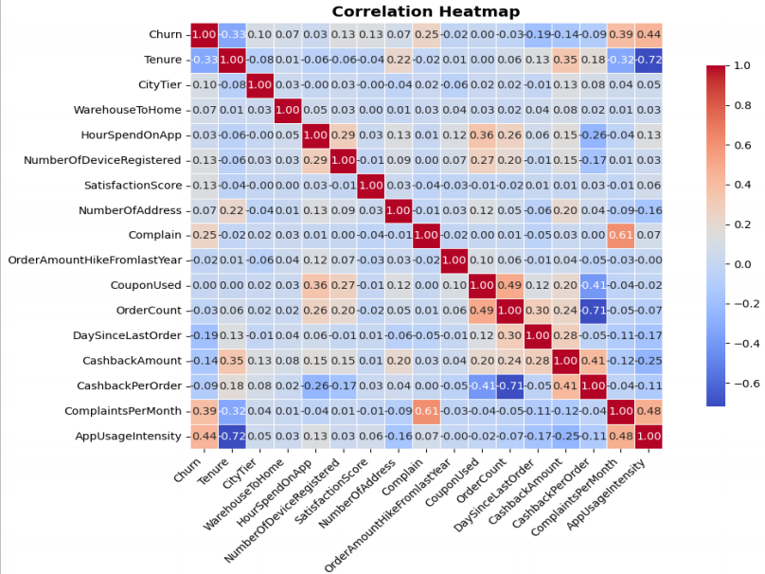
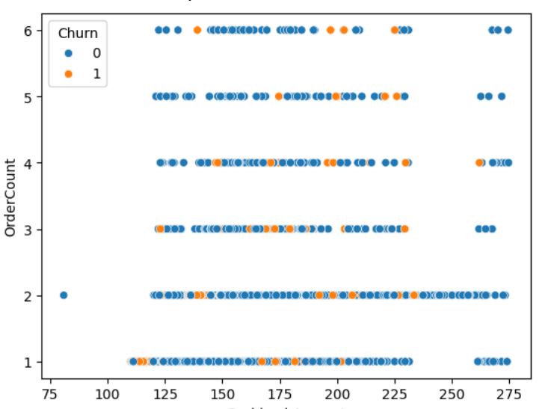
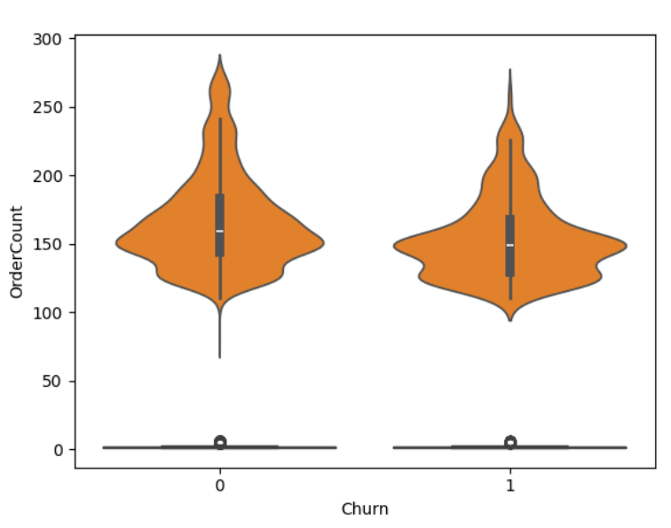
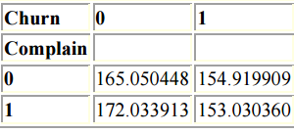
High orders ------ less likely to churn
More cashback ---- higher retention
Complaints ---- high churn risk
Frequent app use ----- engagement ----- loyalty
Exploring the World of Customers

Slide 14
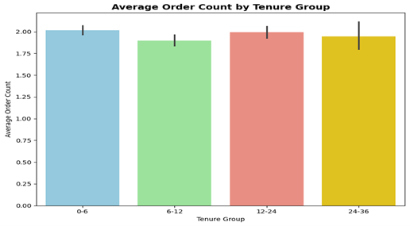
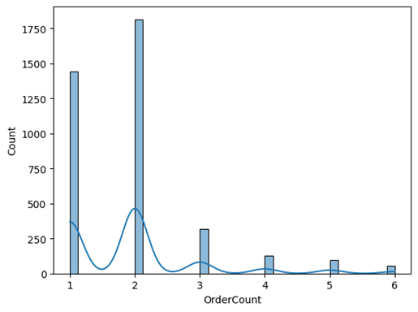
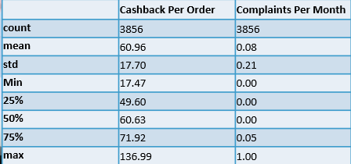
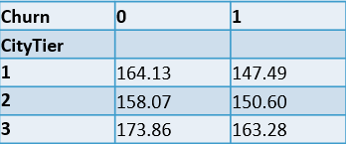
Order Count Distribution : Most users are low-frequency shoppers — room to boost engagement.
Average Order Count by Tenure Group : New users order slightly more initially → focus on long-term retention.
Cashback by City Tier & Churn : More cashback may encourage loyalty.
CashbackPerOrder & ComplaintsPerMonth High cashback correlates with satisfaction; complaints are rare but impactful.
Exploring the World of Customers

Slide 15
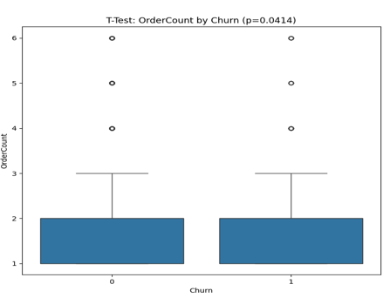
Null Hypotheses
Order Count By Churn
Cashback By Churn
Complain Vs Churn
Coupon Vs Orders
Null Hypothesis (H₀): No difference in average order count between churned and retained customers.
Test: Independent T-Test
Result (p ≈ 0.04): Reject H₀ – the difference is statistically significant.
Interpretation: Retained customers place more orders on average than those who churn.
Visual Insight: The boxplot shows higher median and order counts for retained users, supporting the result.

Slide 16
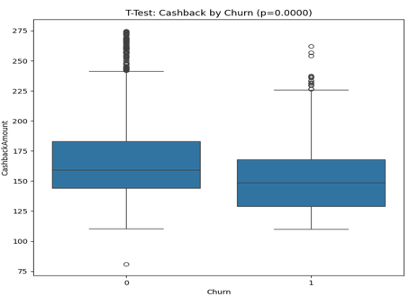
Null Hypotheses
Order Count By Churn
Cashback By Churn
Complain Vs Churn
Coupon Vs Orders
H₀: No difference in cashback between churned and retained customers.
Result (p ≈ 0.0000): Reject H₀ – the difference is highly significant.
Interpretation: Retained users receive more cashback, indicating incentives help reduce churn.
Boxplot: Shows clearly higher cashback for retained customers.

Slide 17
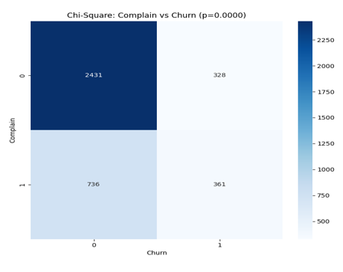
Null Hypotheses
Order Count By Churn
Cashback By Churn
Complain Vs Churn
Coupon Vs Orders
H₀: Complaints and churn are unrelated.
Result (p ≈ 0.0000): Reject H₀ – they are significantly related.
Interpretation: Complaining customers are more likely to churn, highlighting the need for better service.
Heatmap: Shows complaints concentrated among churned users.

Slide 18
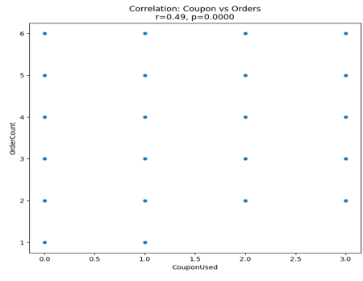
Null Hypotheses
Order Count By Churn
Cashback By Churn
Complain Vs Churn
Coupon Vs Orders
H₀: No correlation between coupon use and order frequency.
Result: r = +0.64, p = 0.0000 → strong, significant positive correlation.
Interpretation: More coupons used = more frequent orders.
Scatterplot: Shows a clear positive trend.

Slide 19
Predictive Analysis
Logistic Regression
Random Forest
To prepare the data for machine learning — separating the input features from the output label so the
model can learn the relationship and predict churn.
To train the model 80% of the data and test its performance on 20% data — helping evaluate how well it generalizes.
In [35}:
features= [‘Tenure’,’OrderCount’,’Complain’,’CashbackAmount’,’HourSpenOnApp’,]
X=data[features]
y= data[‘Churn’]
from sklearn.model_selection import train_test_split
X_train, X_test, y_train, y_test = train_test_split(X, y, test_size=0.2, random_state=42)

Slide 20
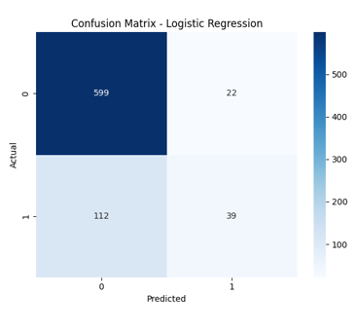
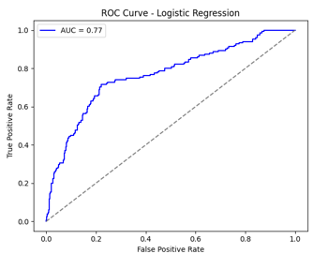
Predictive Analysis
Logistic Regression
Random Forest
In [38]:from sklearn.linear_model import LogisticRegression
lr = LogisticRegression()
lr.fit(X_train_scaled, y_train)
--- Logistic Regression ---
Accuracy: 0.82
Precision: 0.63
Recall: 0.25
F1 Score: 0.36
Confusion Matrix
[[599 22]
[ 112 39]]

Slide 21
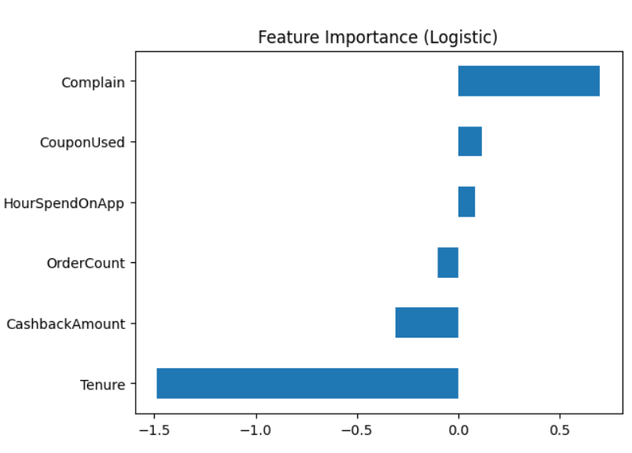
Predictive Analysis
Logistic Regression
Random Forest
In [43]:
coef = pd.Series(lr.coef_[0], index=features)
coef.sort_values().plot(kind='barh', title="Feature Importance (Logistic)")
Shows which features most influence churn
in the Logistic Regression model.

Slide 22
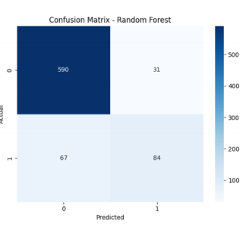
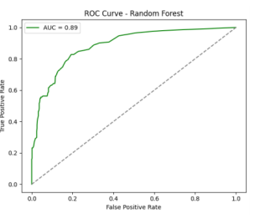
Predictive Analysis
Logistic Regression
Random Forest
In [39]:
from sklearn.ensemble import RandomForestClassifier
rf = RandomForestClassifier(n_estimators=100, random_state=42)
rf.fit(X_train, y_train) # No scaling needed
--- Random Forest---
Accuracy: 0.87
Precision: 0.73
Recall: 0.55
F1 Score: 0.63
Confusion Matrix
[[590 31]
[ 67 84]]

Slide 23
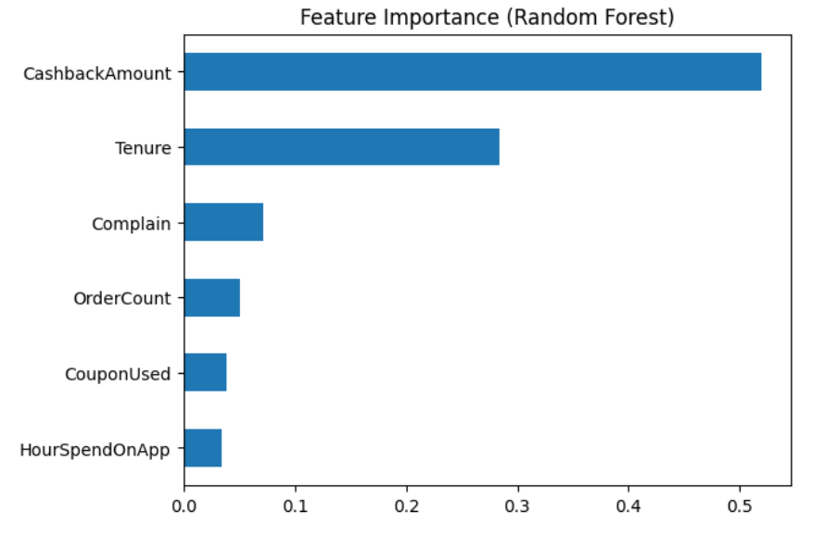
Predictive Analysis
Logistic Regression
Random Forest
In [44]:
import matplotlib.pyplot as plt
importances = pd.Series(rf.feature_importances_, index=features)
importances.sort_values().plot(kind='barh', title="Feature Importance (Random Forest)")
plt.show()
Shows which features most influence churn
in the Random Forest model.

Slide 24
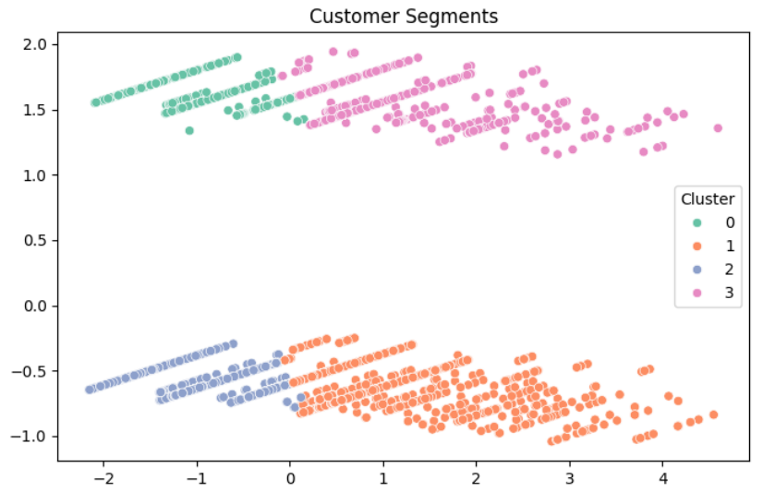
Dividing the Kingdom – Clustering
Cluster3: High Spenders
Cluster2: Occasional Users
Cluster1: Budget Shoppers
Cluster0: Complaint Prone Users
In [48]:
k = 4
kmeans = KMeans(n_clusters=k, random_state=42)
clusters = kmeans.fit_predict(X_scaled)
data['Cluster'] = clusters
To group customers based on similar behaviors (e.g. spending, complaints). Supports segmentation and
targeted marketing strategies

Slide 25
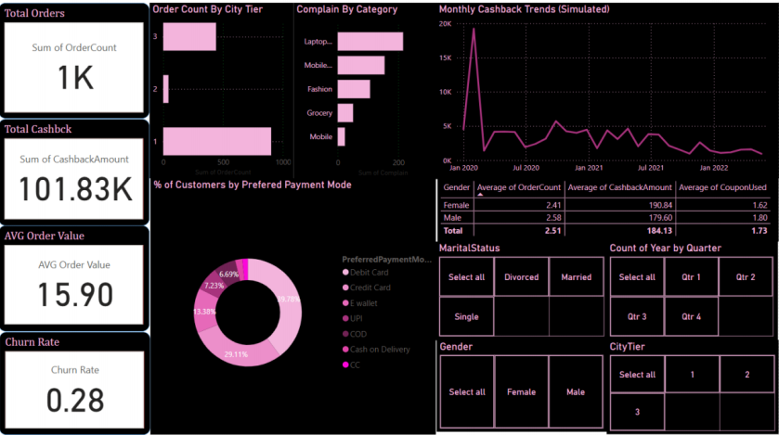
Dividing the Kingdom – Clustering
Cluster3: High Spenders
Cluster2: Occasional Users
Cluster1: Budget Shoppers
Cluster0: Complaint Prone Users
High orders, high cashback, few complaints, low coupon use.
Loyal, valuable customers.
Strategy: Retain with loyalty perks and exclusive offers.

Slide 26
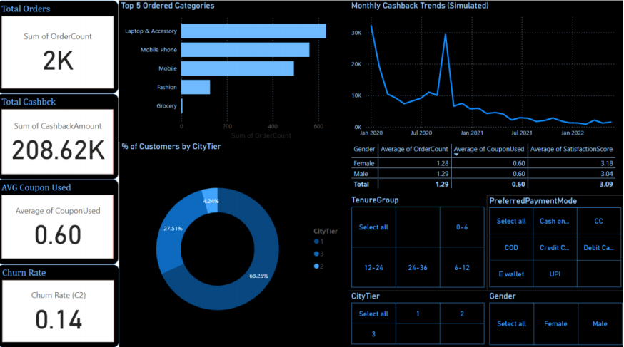
Dividing the Kingdom – Clustering
Cluster3: High Spenders
Cluster2: Occasional Users
Cluster1: Budget Shoppers
Cluster0: Complaint Prone Users
Low orders, low cashback/coupon use, few complaints.
Inactive, low-engagement shoppers.
Strategy: Use re-engagement offers and onboarding guides.

Slide 27
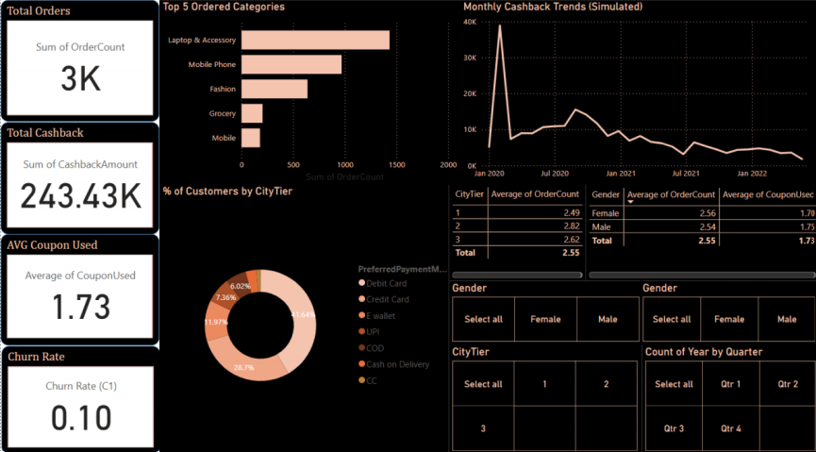
Dividing the Kingdom – Clustering
Cluster3: High Spenders
Cluster2: Occasional Users
Cluster1: Budget Shoppers
Cluster0: Complaint Prone Users
Low-moderate orders, high coupon use, moderate cashback, few complaints.
Price-sensitive deal seekers.
Strategy: Attract with discounts, promos, and flash sales.

Slide 28
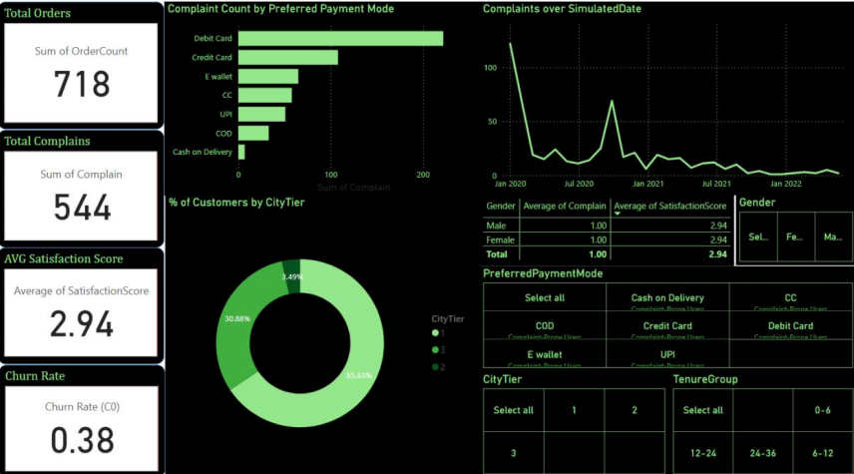
Dividing the Kingdom – Clustering
Cluster3: High Spenders
Cluster2: Occasional Users
Cluster1: Budget Shoppers
Cluster0: Complaint Prone Users
High complaints, average/low spend, moderate coupons/cashback.
At-risk, dissatisfied customers.
Strategy: Boost support and offer recovery incentives.

Slide 29
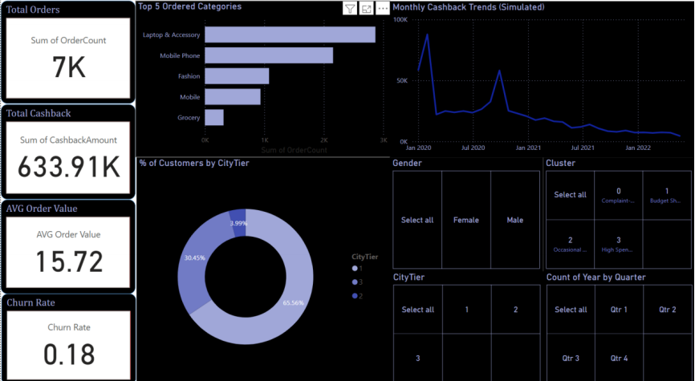
From Insight to Action – Power BI Dashboards
We designed interactive dashboards showing:
Churn risk by region & device
Customer behavior KPIs
Segment performance
Real-time trends
Empowering stakeholders to take action instantly.

Slide 30
- Complaints are red flags
- Cashback improves loyalty
- Frequent app use = retention
Clustering enables personalization
- BI dashboards bridge tech & decision-making
What We Learnt ??

Slide 31
This project proves that data science isn’t just about numbers.
It’s about understanding people.
When we listen to customer behavior through data, we gain the power to build loyalty, reduce churn, and write a success story for every e-commerce business.
The Final Chapter – Conclusion

Slide 32
Done By:
Mariam Luay Alhusseini
Thank
You

